Slide 1
DTI5125
Group Assignment 3: Literature Review
Answering Arabic Complex Questions[1]
Group: 13

Slide 2
Table of contents
Motivation
Introduction
Difficulties of Arabic Language
Methodology
Experimental Evaluation
Conclusion
References

Slide 3
Motivation
Factoid questions and definitional questions are generally utilized in ongoing works in Question Answering (QA). These inquiries can be responded to by a Named Entity (NE) or a short sentence. In any case, a really provoking and more uncommon inquiry to manage is the complicated inquiry, or why-question. This issue spurred us to foster another inquiry answer framework for addressing Arabic complex inquiries in the medical area.

Slide 4
Introduction
Arabic is one of the most difficult languages ​​to process and understand.
QA Arabic system takes a question, analyzes it, understands the meaning and then provide the exact answer.
Problem Definition: the proposed Arabic medical QA systems are so limited in terms of their performance as well as in terms of the types of questions they are de-signed to answer.

Slide 5
Introduction
Claim: introducing a new approach to handling Arabic complex question (Why question) in the medical field .
The publishers use a dictionary for medical field using “NooJ platform” to apply his approach.

Slide 6
Difficulties of Arabic Language
Morphological Richness (lack of diacritics)
Orthographic Ambiguity
Orthographic Inconsistency
Dialectal Variation

Slide 7
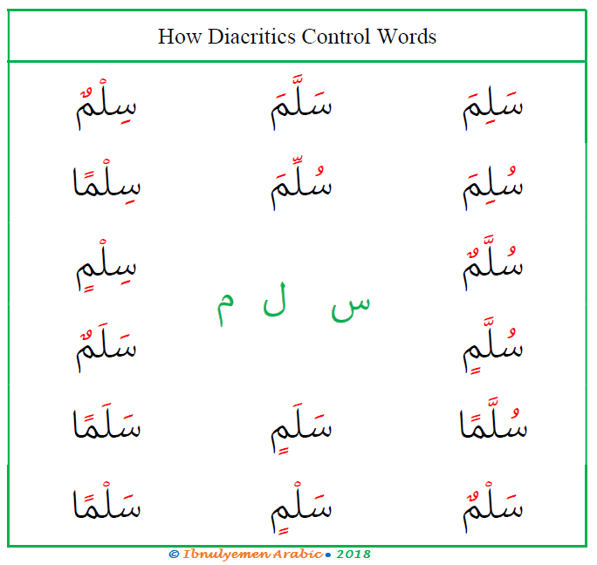
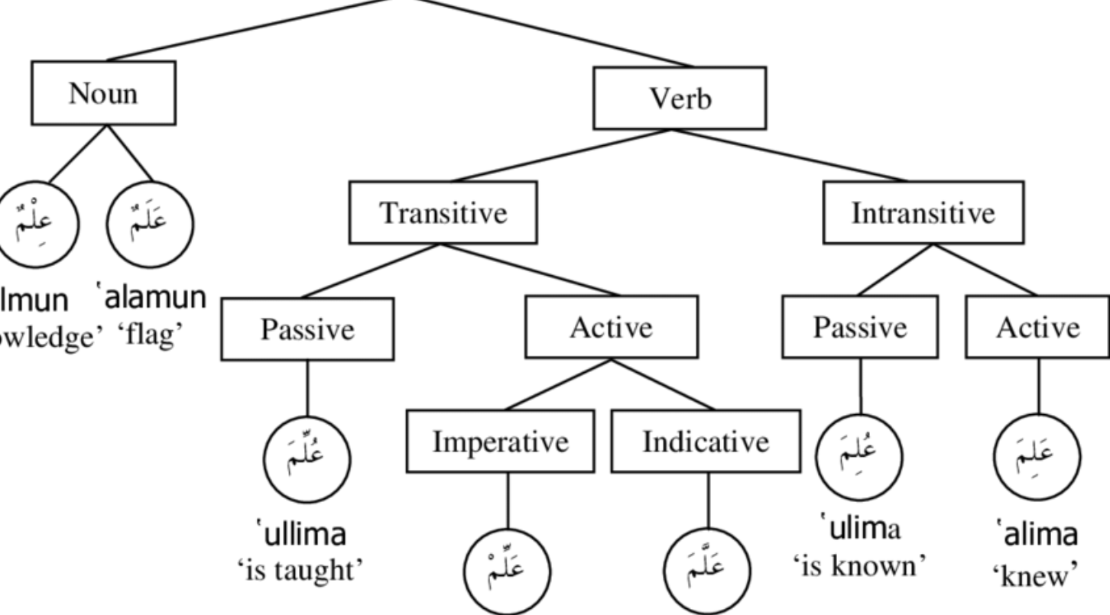
Difficulties of Arabic Language
Morphological Richness (lack of diacritics): The same root can have many different forms
Examples:
“لماذا يولد الرضيع مشوها؟” Why is a baby born with a deformity?
يولِّد means “Generates”
لَعَبَ، يَلعَب، لِعْب، يُلاعِب Playing with – Play – Playing - Played
[5]
[6]

Slide 8
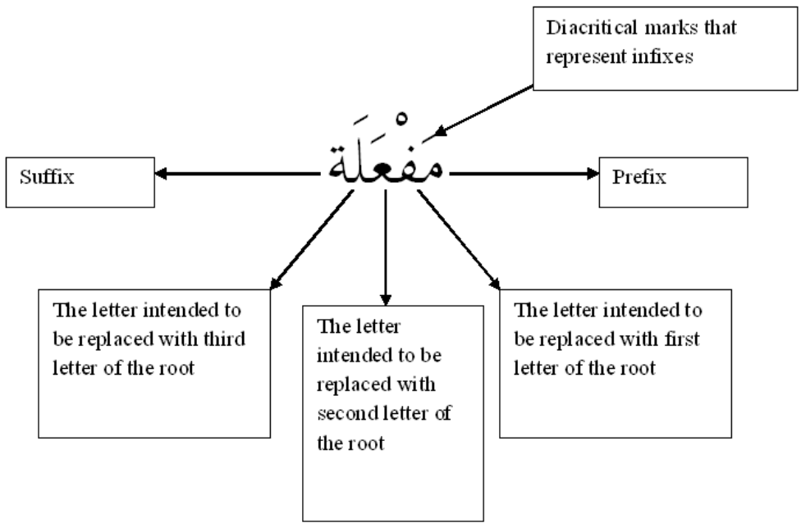
Difficulties of Arabic Language
Orthographic Ambiguity على أخذ المال كوارث شرعى Ali Took the money as a legitimate inheritor
[4]

Slide 9
Difficulties of Arabic Language
Orthographic Inconsistency Since Arabic is a phonetic language (what is written is what is said), there can be different ways to write the same word when writing in dialectal Arabic, for which there is no agreed-upon standard على أخذ المال كوارث شرعى Ali Took the money as a legitimate inheritor
Also “كوارث” means “Catastrophes”
أَيْن – وِين – فِين – أَينَ
Where
[2]

Slide 10
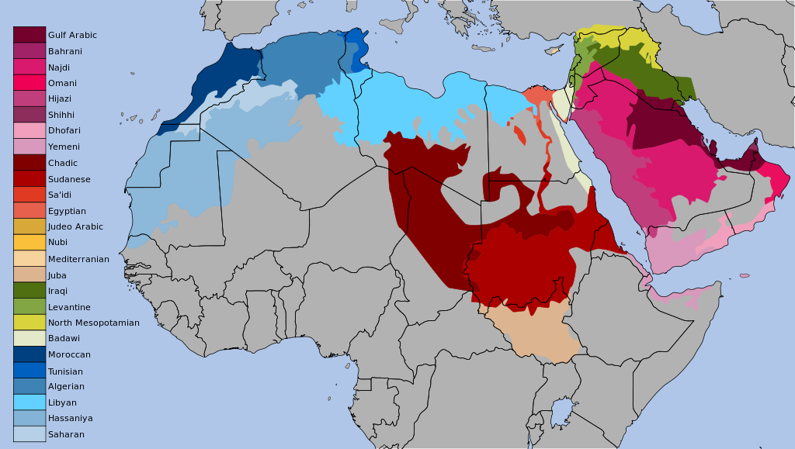
Difficulties of Arabic Language
Dialectal Variation
[3]

Slide 11
Methodology
Study the corpora
Analyzing the Question
Reviewing the related documents
Answer Extraction

Slide 12
Methodology
Study of the corpora Collected the data from the internet from several sources such as discussion forms , frequently asked question (FQA) and some questions translated from the Text Retrieval Conference (TREC). Collected 145 why question and gather the text for these question from the internet.
[1]

Slide 13
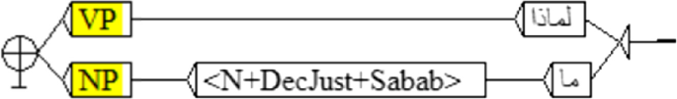
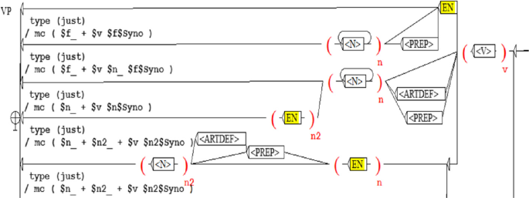
Methodology
Analyzing the Question
[1]

Slide 14
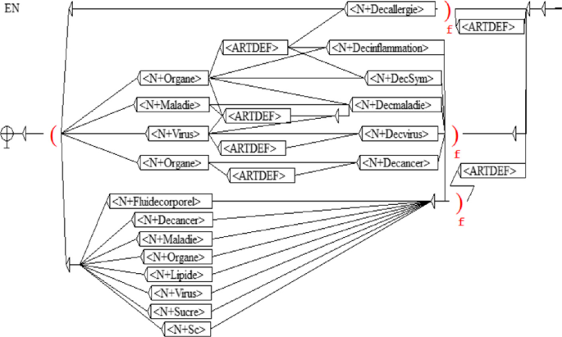
Methodology
Analyzing the Question
[1]

Slide 15
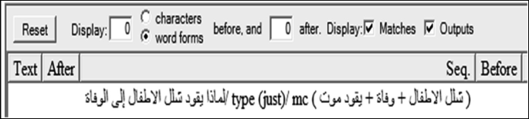
Methodology
Analyzing the Question
Input
Output
[1]

Slide 16
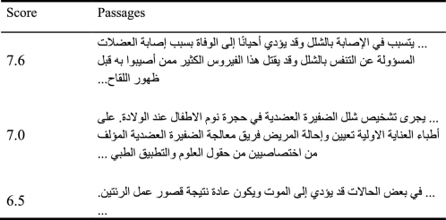
Methodology
Reviewing the related documents Extracted words from the previous module to retrieve a ranked list of candidate documents using the advantage of Lucene Apache for developing a PR module for complex questions.
This QA system is entirely implemented on the Java platform, and Lucene is an open source library written in Java, as well.
[1]
The figure Above shows an example of a ranked list of candidate passages according to the keywords: شلل الاطفال ‘poliovirus’, يقود ‘lead’, وفاة ‘death’, and موت ‘death’.

Slide 17
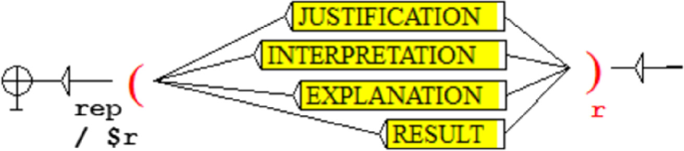
Methodology
Answer Extraction In addition to answering the question, in this paper used four relations: justification, interpretation, explanation, and result as shown in Figure below
[1]

Slide 18
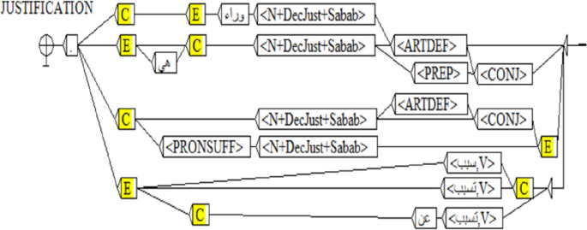
Methodology
Answer Extraction Extracted patterns are transformed into transducers
[1]

Slide 19
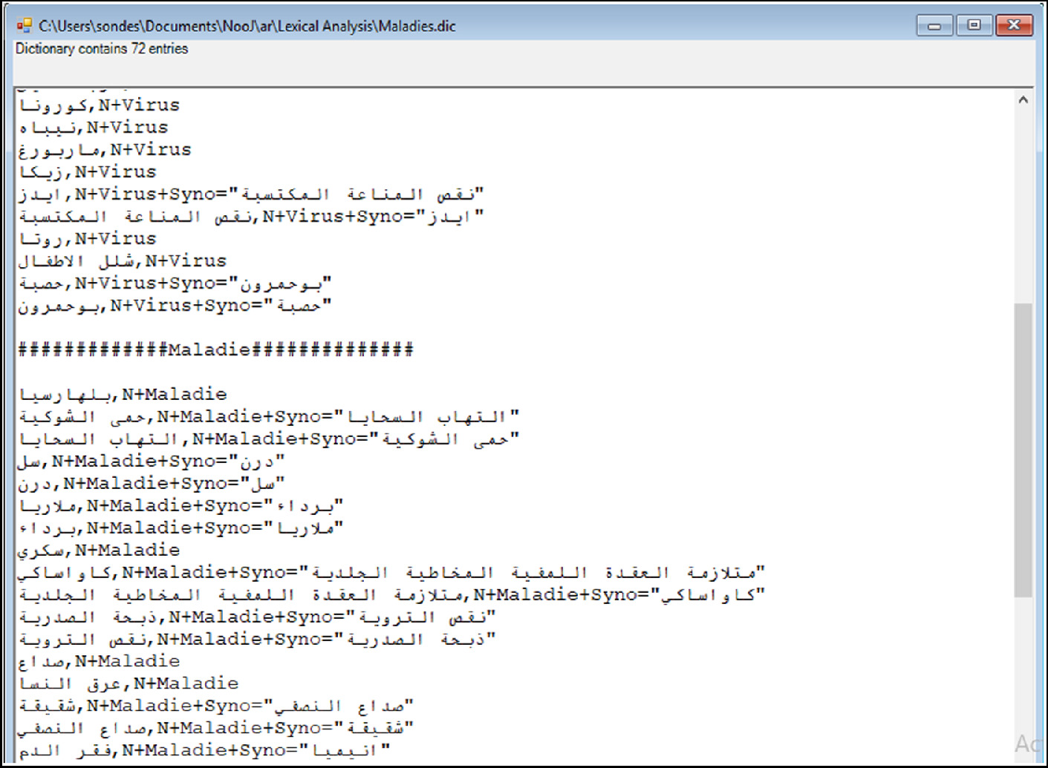
Experimental Evaluation
Extraction from a dictionary
They have conducted a set of experimentations to evaluate their proposal efficiency. Therefore, they have exploited the test corpus Open Source Arabic Corpora (OSAC).
[1]

Slide 20
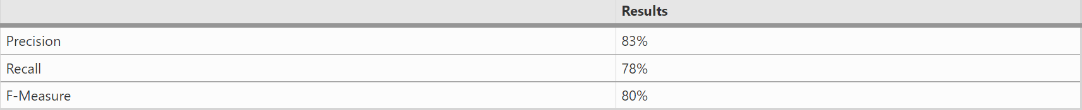
Experimental Evaluation
Results
After testing 130 complex questions on the test corpus, They have obtained these results
This error due to some missing in the preprocessing part they should do a normalization for text like ‘أْاّ’ to ‘ا’ this may improve the result in the future.
[1]

Slide 21
Conclusion
The four approaches that the publisher applied achieve a great result but in the future work it is needed to apply some normalization preprocessing to achieve a higher result.
Here the publishers mentioned only their result and did not support their results by others.
Also need to mention all the models that they used in the system and illustrate the “NooJ” platform even more as they used it in applying their approach.
They could detect “لماذا” why and “ما” what and could search for the related topics of the question at a high precision and F-score with an approachable method.

Slide 22
References
[1] S. Dardour, H. Fehri, and K. Haddar, “Answering Arabic Complex Questions,” Communications in Computer and Information Science, pp. 185–195, 2021, doi: 10.1007/978-3-030-70629-6_16. (Main Article)
[3] “The Problem of Maps مشكلة الخرائط,” From Fuṣħā to ‘Āmmiyya من الفصحى إلى العامية, Sep. 27, 2012. https://learnammiyya.wordpress.com/2012/09/27/the-problem-of-maps-%D9%85%D8%B4%D9%83%D9%84%D8%A9-%D8%A7%D9%84%D8%AE%D8%B1%D8%A7%D8%A6%D8%B7
[4] H. Y. Taha, “Reading and Spelling in Arabic: Linguistic and Orthographic Complexity,” Theory and Practice in Language Studies, vol. 3, no. 5, May 2013, doi: 10.4304/tpls.3.5.721-727.
[2] R. Pelgrim, “Arabic NLP: Unique Challenges and Their Solutions,” Medium, Feb. 21, 2022. https://towardsdatascience.com/arabic-nlp-unique-challenges-and-their-solutions-d99e8a87893d#:~:text=Working%20with%20Arabic%20text%20in%20NLP%20projects%20presents%20(at%20least
[5] “Diacritics in Arabic (3),” Ibnulyemen Arabic, Oct. 09, 2018. https://www.ibnulyemenarabic.com/arabic-language/arabic-diacritics-function-and-role
[6] M. Attia, “Handling Arabic Morphological and Syntactic Ambiguity within the LFG Framework with a View to Machine Translation Some of the authors of this publication are also working on these related projects: Applications of Neural Nets in Arabic NLP View project Dialectal Arabic Processing View project,” 2014.

Slide 23
Thank You

